Slide 1
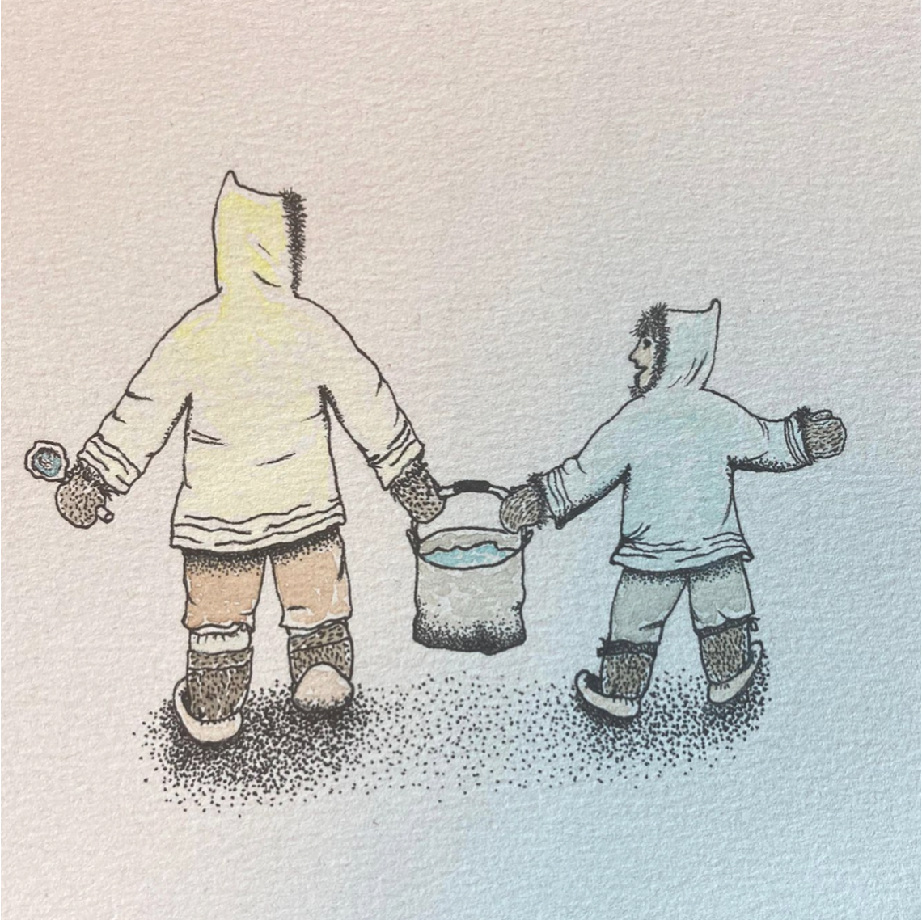
Social Sciences
Grade 3
Teacher guide

Slide 2
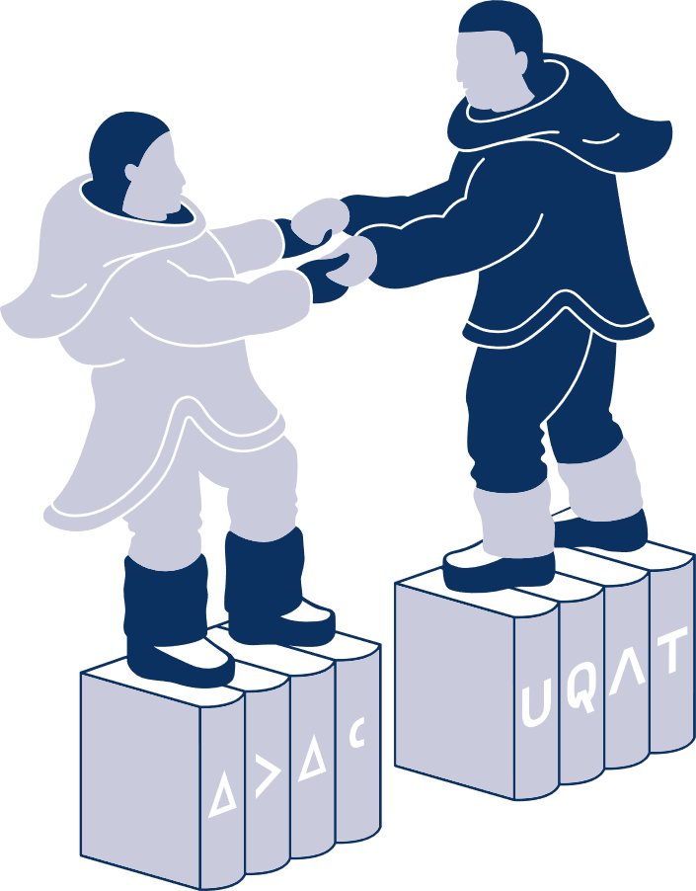


Edition
Véronique Paul, Daphnée Perron-Cordero, Elisapie Lamoureux
Layout
Daphnée Perron-Cordero
Revision and adaptation
Elisapie Lamoureux
Illustrations
Qumaq Iyaituq, Passa Mangiuk
Archives photos
Avataq Cultural Institute
A heartfelt appreciation to the photographers,
your dedication of storytelling through photography
livened up this booklet.
Special thanks to Glorya Pellerin for her support.
This booklet is a collaboration between
Tukisivallirutitsanut Parnaitiit, IPUIT and URFDÉMA.
Realized with the financial support of UQAT and the Quebec Government.

Slide 3
Notice:
Teaching sensitive subjects
This booklet contains teaching-learning situations (TLS) that tackles sensitive topics. Before teaching these topics, we recommend you take ownership of the material to target TLS that might be triggering for you or your students.
It is suggested to be prepared before teaching sensitive subjects. If a teacher feels like not knowing enough about a subject before teaching it, we advise you refer to Veronique Paul’s thesis beforehand. If you need further information, feel free to contact Veronique Paul at veronique.paul2@uqat.ca. Ensure a safe space where every pupils can share and reflect on their learnings. Only touch on subjects you feel comfortable with.
If you would like to feel better equipped to teach sensitive subjects, here are some papers and tools :
In English:
Teaching Tolerance. (2021). Let’s talk! Facilitating critical conversations with students. https://www.learningforjustice.org/sites/default/files/2021-01/TT-Let-s-Talk-Publication-January-2020.pdf
University of Michigan. (n.d.). Making the Most of ‘’Hot Moments’’ in the Classroom. https://docs.google.com/document/d/1tuMuMVnI7soHLcTNxzCTqcpkun0ASHW_WvNuxphyyxA/edit
In French:
Hirsch, S., Audet, G. et Turcotte, M. (2015). Vivre ensemble: aborder les sujets sensibles avec les élèves. https://www.cipcd.ca/wp-content/uploads/2014/04/CSMB_-Guide_sujets-sensibles_final. pdf
Hirsch, S. et Audet, G. (2019). Éducation Canada : Trousse de discussion. https://www.edcan.ca/wp-content/uploads/Discussion-Kit-September-2019-Hirsh.pdf
Moisan, S., Hirsch, S., Éthier, M.-A., Lefrançois, D. et Falaize, B. (2022). Objets difficiles, thèmes sensibles et enseignement des sciences humaines et sociales. Fides éducation.
2

Slide 4
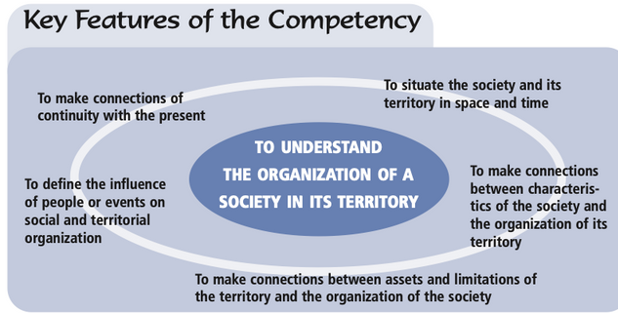
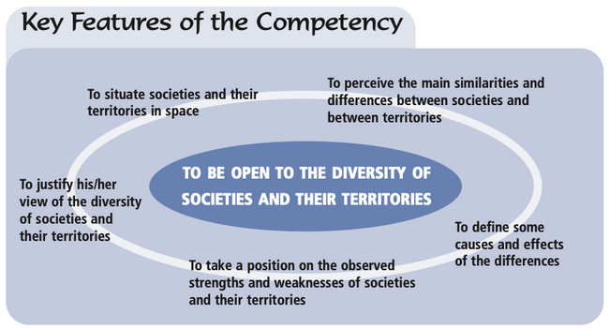
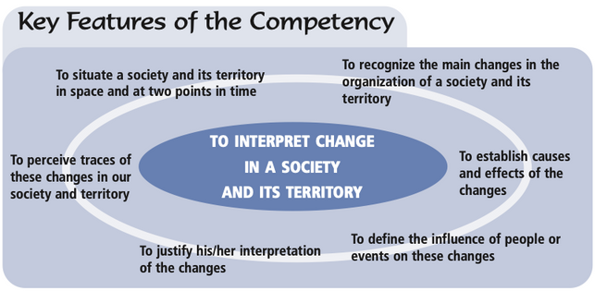
Geography, History and Citizenship Education Competencies in cycles 2 and 3
(program from the MEQ)
COMPETENCY 1
COMPETENCY 3
COMPETENCY 2
3

Slide 5
Table of contents
Content | Slide #
Introduction | 1 to 4
History and Geography techniques | 5 to 15
Chapter 1: Up until 1830’s, what was the Inuit way of life? | 16 to 18
Chapter 2: Between 1830 and the 1900s, what changed with the Hudson’s Bay Company’s establishment? | 19 to 23
Chapter 3: Between 1900 and the 1950’s, what changed when the missionaries arrived and how did Inuit sedentarized? | 24 to 29
Chapter 4: Between the 1950’s and the 1980’s, how did Inuit start attending school? | 30 to 35
Chapter 5: Between 1953 and the 1980’s, how were the co-op created? | 36 to 41
Conclusion | 42 to 43
Reference list | 44 to 46
4

Slide 6



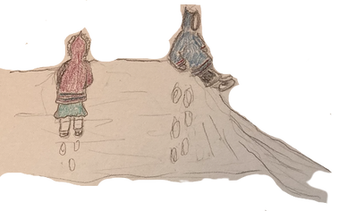
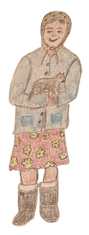
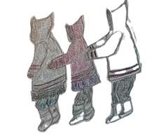

a little about my history
When I was 5 years old, my favourite activity was to : personal response
Today, my favourite activity is to: personal response
In my class last year, we were personal response students.
In my class this year, there are personal response students.
My birthday is on: personal response
My best friend's birthday is on : personal response
There are personal response months between my birthday and his/her birthday.
Draw the route from the school to your house in the section below.
In which direction is your house located relative to the school?
N ____ E ____ S ____ W____
5
Notes:
INTRODUCTION TO HISTORY (TLS #1)
LESSON OBJECTIVES :
At the end of this lesson, the pupils will understand elements of the past and the present from their own lives.
TEACHING STRATEGIES :
Lesson
Question plan
Exercises in the booklet
INTRODUCTION
Presentation of History and how we need to understand what happened in the past to understand what is happening in our present. Ask the pupils what has changed in their lives or in their family members live.
ACTION
Slide 5: pupils answer questions #1 to #7 individually
CONSOLIDATION
Teacher shows aerial view of their community to help students answer questions #8-9 (see Word document titled « Lesson plans for social sciences booklet» to see an example of this activity)
Ask pupils to compare their answers and to determinate differences between each other’s answer

Slide 7
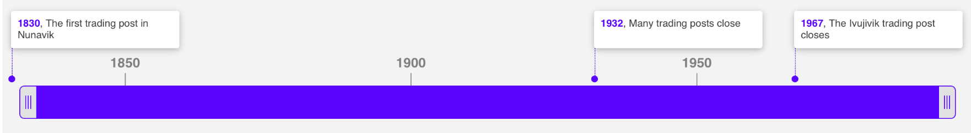
History techniques
Timeline
A timeline always has a title to illustrate its subject
Title :
History of Hudson's Bay Company Trading Posts in Nunavik
The little lines defines the scale: in this example, each line represents 50 years
The events on a timeline are in chronological order meaning they are presented in the order in which they happened from oldest to newest.
What is the title of this timeline?
History of Hudson’s Bay Company Trading Posts in Nunavik
How many years are there between the first trading post in Nunavik and the closing of Ivujivik trading post? 137 years
What is the scale of this timeline? 50 years
6
Notes:
TITLE : INTRODUCTION TO THE TIMELINE (HISTORY) (TLS #2)
DESCRIPTION OF THE SITUATION
LESSON OBJECTIVES :
At the end of this lesson, pupils will understand how a timeline works and create a timeline about their lives.
TEACHING STRATEGIES :
Question plan
Lesson
Exercises in the booklet
INTRODUCTION
Teacher explains how we can visualize a series of event chronologically.
ACTION
Slide 6: Teacher tells the history of HBC on the territory according to the timeline presented.
Teacher explains what are the elements that should appear on a timeline and their use.
Slide 6: Teacher and pupils do together the exercises #1-2-3
CONSOLIDATION
Slide 7: pupils do the activity to make their own timeline. Ask pupils to show their timelines to their colleagues and determinate difference between each other’s timeline
Teacher could also use a RecitUS activity on how to make a Timeline (https:/docs.google.com/document/d/19cKbEP4uU_emxmgNkJKUb6QJqlghbuCcXyoYjp41e5w/edit)

Slide 8



History techniques
Make your own timeline!
Timeline
Cut the life events
Place the events in chronological order
Paste them on the year they happened
Give your timeline a title!
my birthday
my first year of school
my first steps
the birthday of a sibling
Title : Example of title : The life events of my life
Scale : each line represents 1 year
7

Slide 9
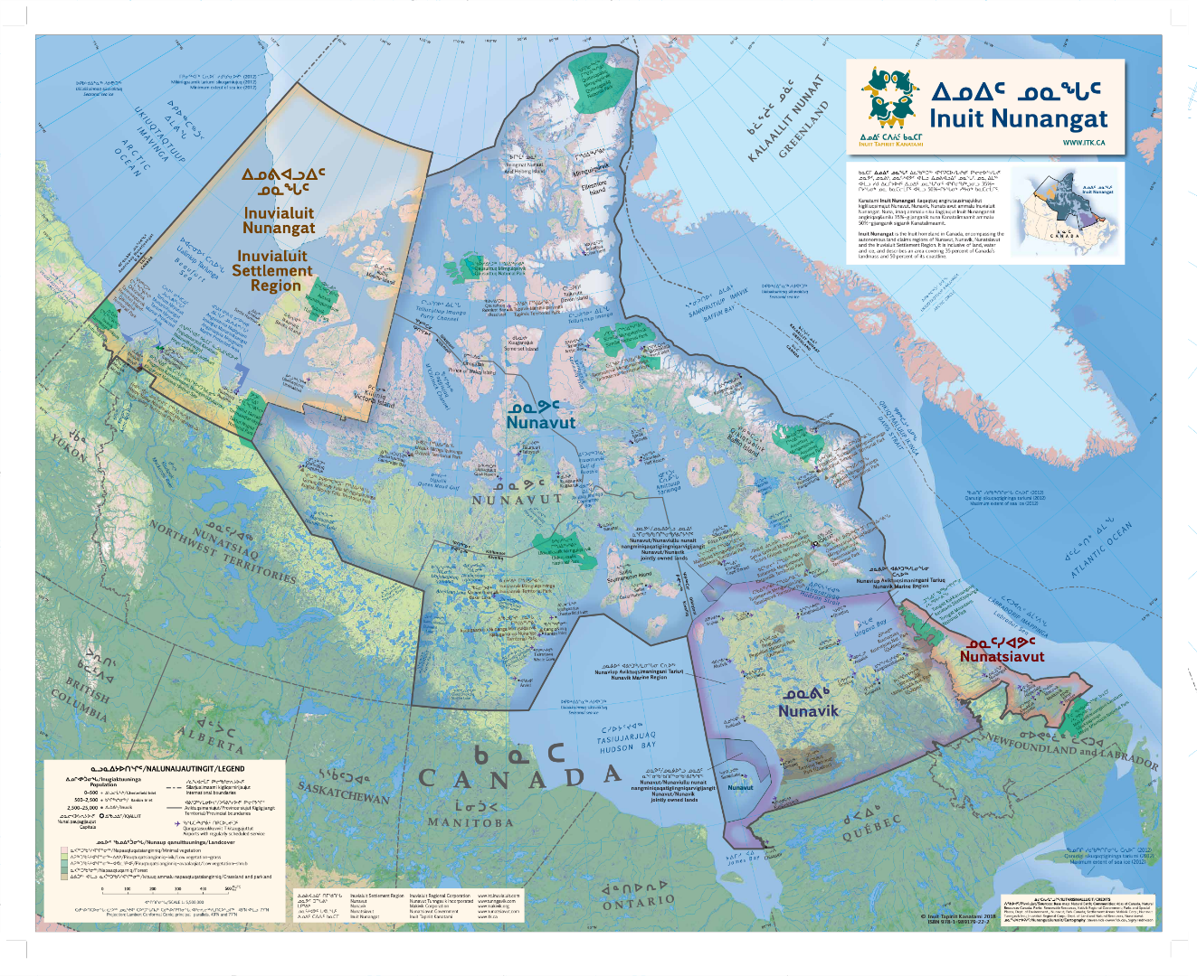
Geography techniques
Geographical map
A map is a representation of a territory.
Canada and Inuit Nunangat map
A map always has a title.
It tells you what the map is about.
A compass shows
you the cardinal directions.
A legend displays the meaning of the colours or the symbols.
8
Notes:
TITLE : INTRODUCTION TO GEOGRAPHY (TLS#3)
LESSON OBJECTIVES :
At the end of this lesson, pupils will recognize different types of maps as well as situate themselves in the climate they know.
TEACHING STRATEGIES :
Question plan
Lesson
Activities on maps
Exercises in the booklet
INTRODUCTION
Teacher ask pupils why maps are useful, what we can do with them, if they have every use a map.
ACTION
Slide 8 : Teacher introduces pupils to a geographical maps, its elements and their use.
Slide 9: Teacher introduces pupils to a map of the province of Quebec and ask what are the differences they can see.
Slide 10: Teacher introduces a map of Nunavik and the circumpolar world. Teacher asks what is the difference with the province of Quebec map.
CONSOLIDATION
Slide 11: Teacher presents the different climates in Quebec. They ask what is the main climate in what climatic zone they’re in (question #1)
Pupils have access to different maps; they choose one and they colour maps. These maps could be displayed in the classroom.
Resources for maps to print:
https://cge-media-library.s3.ca-central-1.amazonaws.com/wp-content/uploads/2021/04/05163646/Arctic-lessons-En-lesson1.pdf

Slide 10
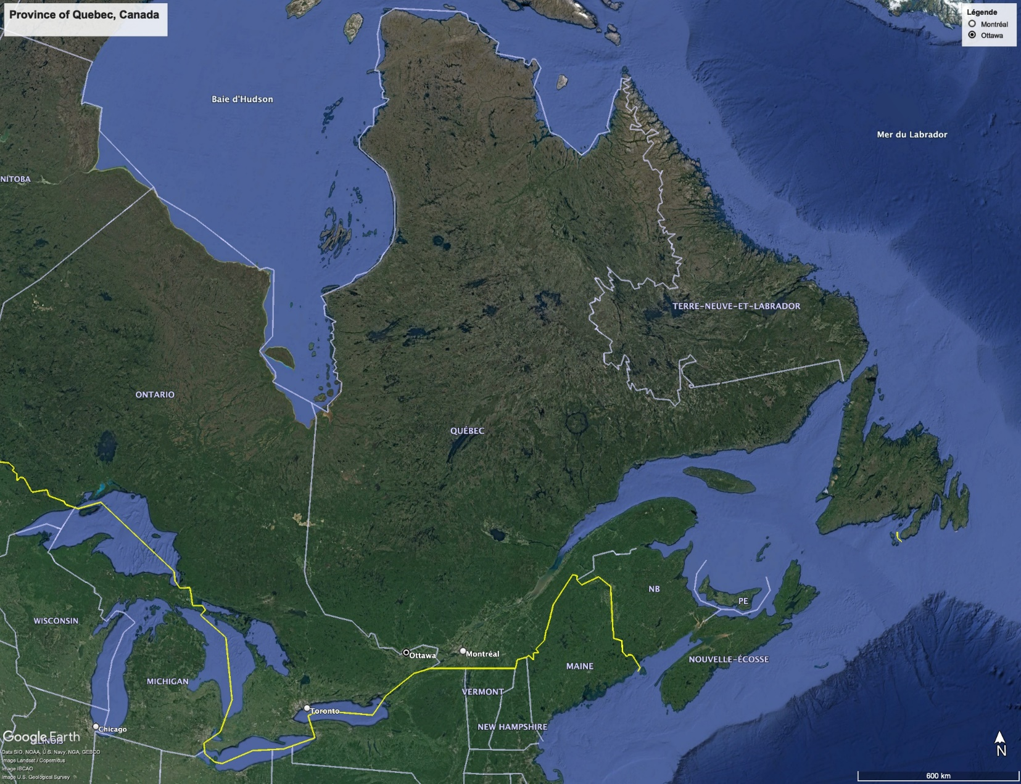
Geography techniques
Province of Quebec map
9

Slide 11
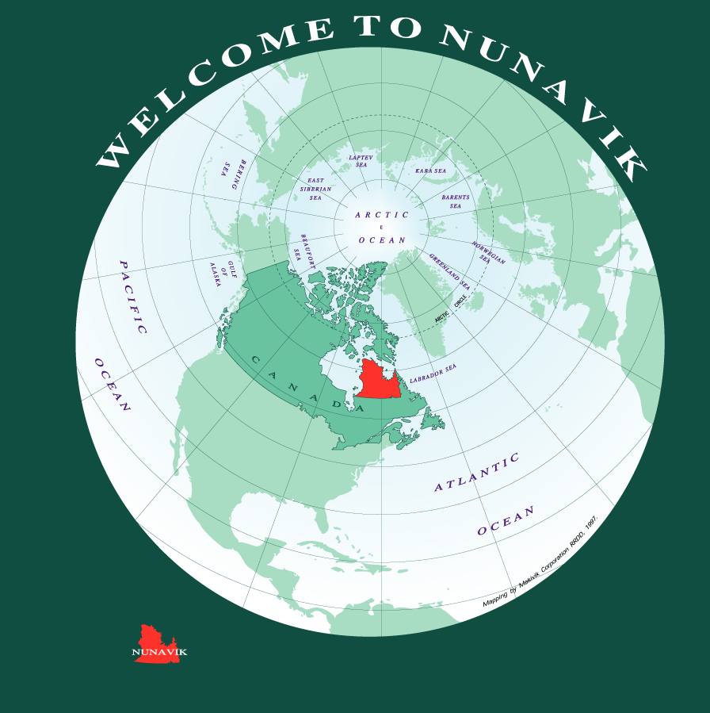

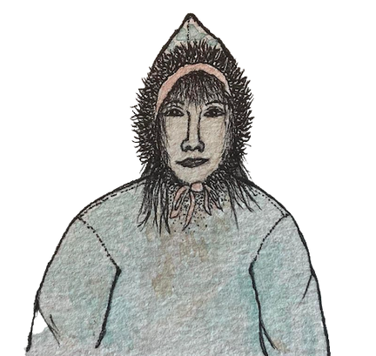
Geography techniques
Nunavik in Canada
Did you know…
We had our own way to map the territory. Watch this video to learn more.
10
Notes:
Video : https://www.youtube.com/watch?v=0YCxBxU6Jmw

Slide 12
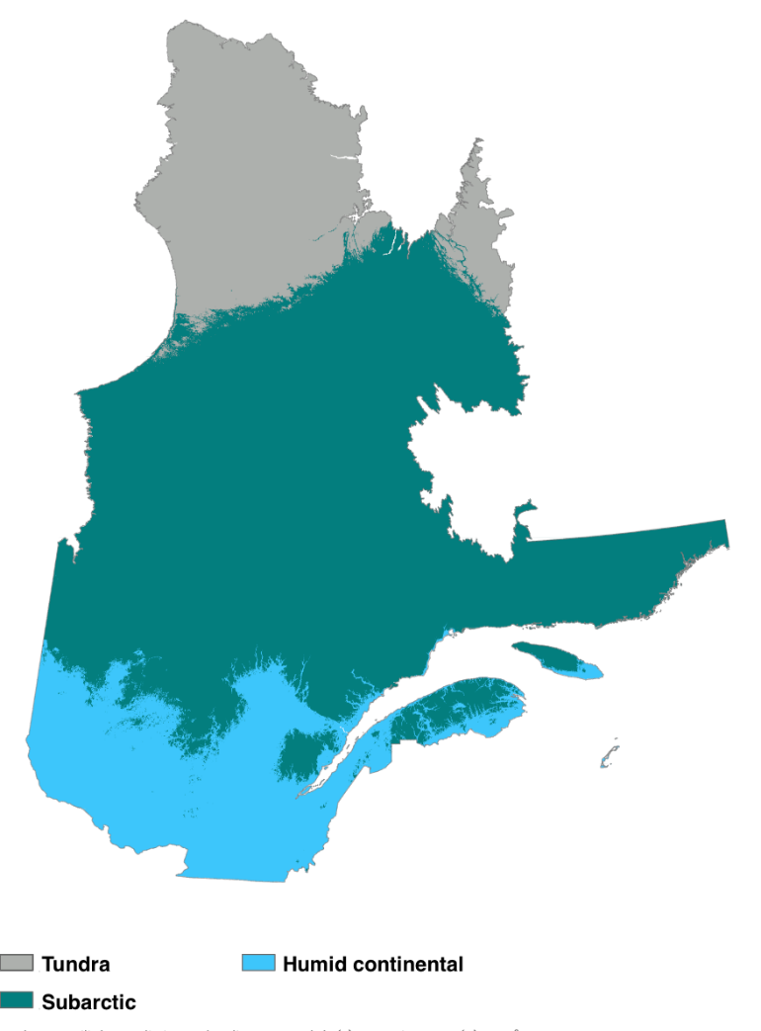
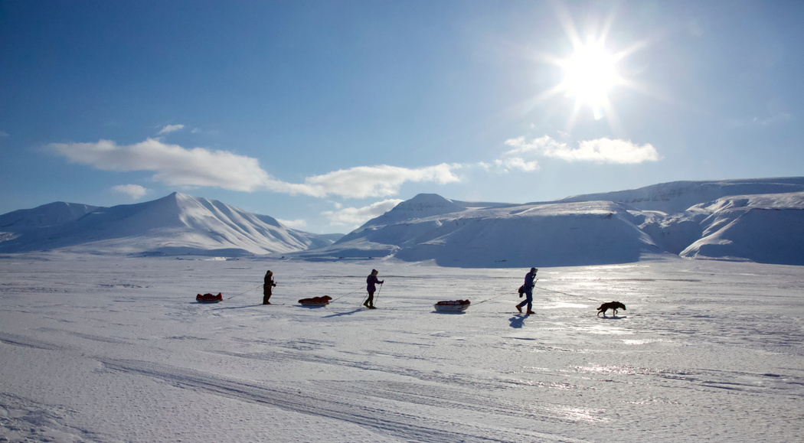
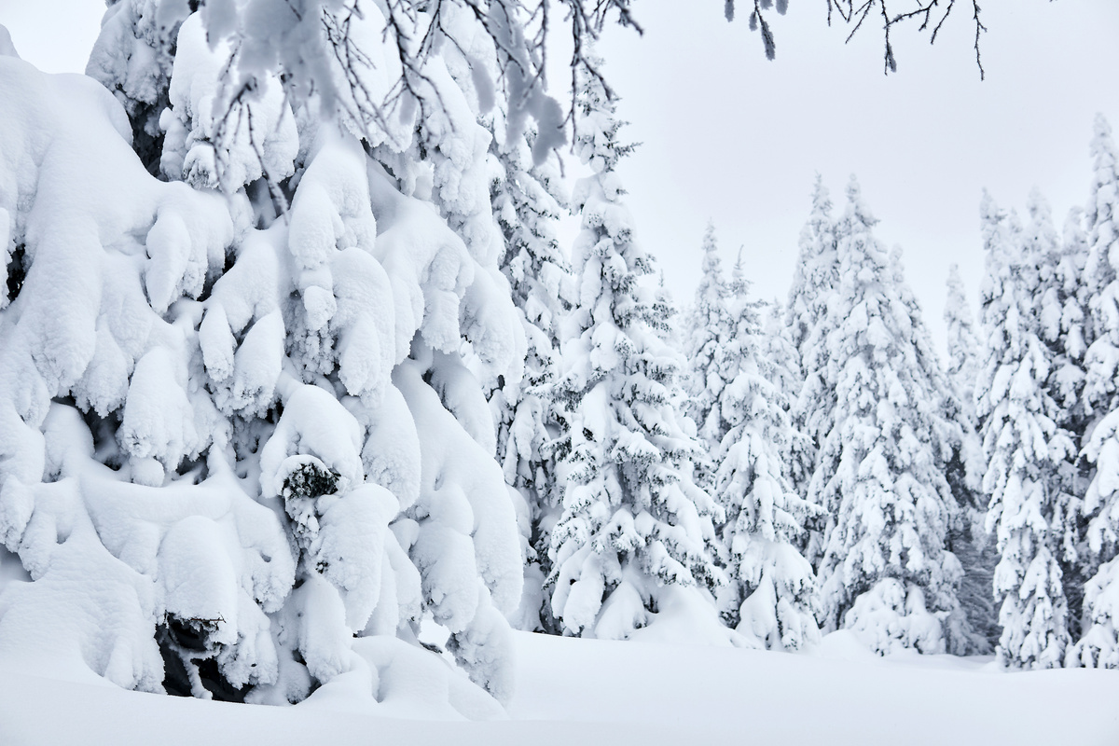
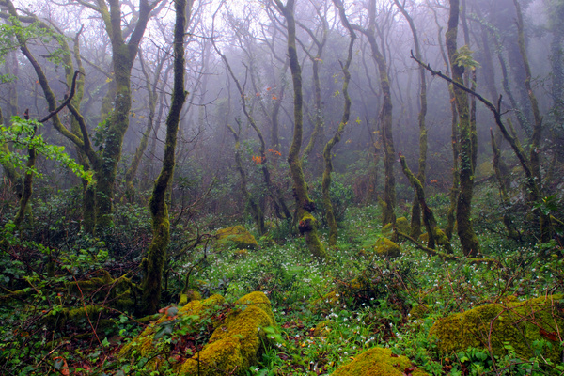
Geography techniques
Climatic zones in the Province of Quebec
What is the climate where you live? Tundra
11

Slide 13
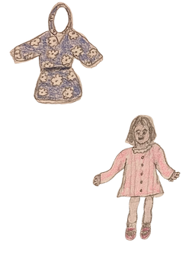
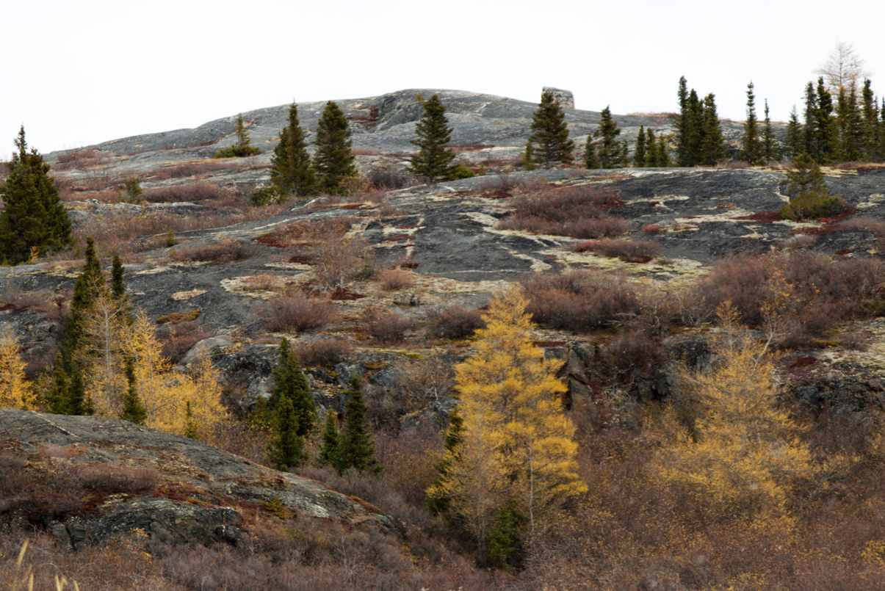
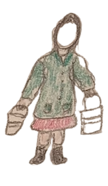
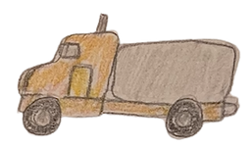
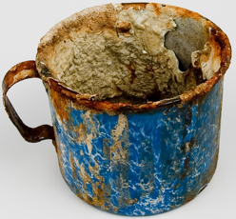
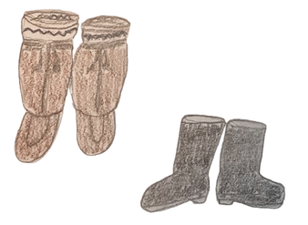
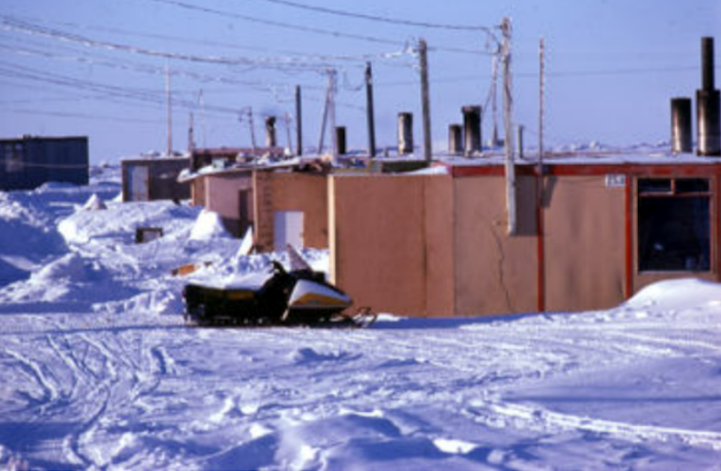
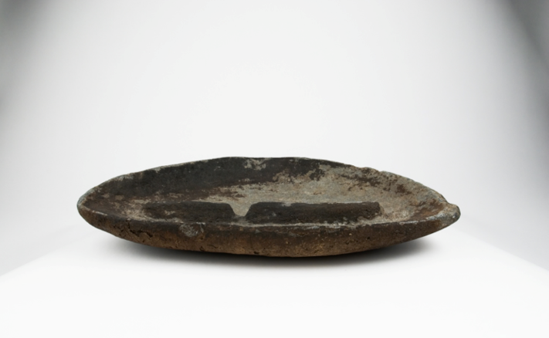
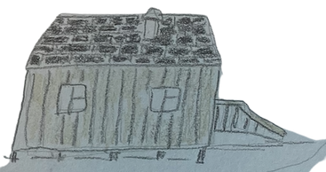
What are documents?
A document can be a picture, a drawing or an object that tells us about the past and the present. It can better the understanding of an organization, the elements of change or the diversity in a society.
photos
drawings
objects
dolls
water
boots
houses
12
Notes:
TITLE : INTRODUCTION TO DOCUMENTS IN SOCIAL STUDIES (TLS #4)
LESSON OBJECTIVES :
At the end of this lesson, pupils will identify different documents who help us understand the past. Pupils will also be introduced to the aspects of society.
TEACHING STRATEGIES :
Question plan
Lesson
Activity
Exercises in the booklet
INTRODUCTION
Teacher ask pupils what can historians use to understand the past.
ACTION
Slide 12: Teacher teacher the types of documents : photos; drawings; objects (artefacts).
Slides 13-14-15: Teacher explains what are different aspects of society and how these aspects are complementary.
CONSOLIDATION
1st suggestion: Teacher can use a RecitUS activity on the interpretation of a document related to the Iroquois’ territory in 1 500 (https://docs.google.com/document/d/11bblkNHh2oX_HAYCybiktT0aFORusBdda1f-gPD2rnM/edit)
2nd suggestion: Teacher could propose an activity where groups of 2-3 pupils are given objects and pretend they find them 200 years from now. What would the people who find it think it would be? They can be creative and imagine what people in the future would think of it.

Slide 14
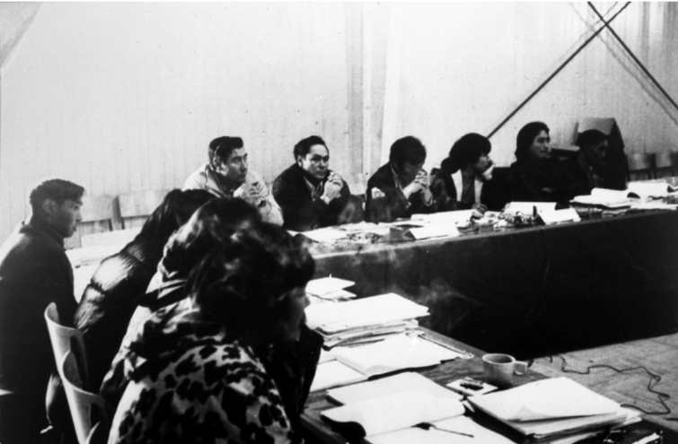
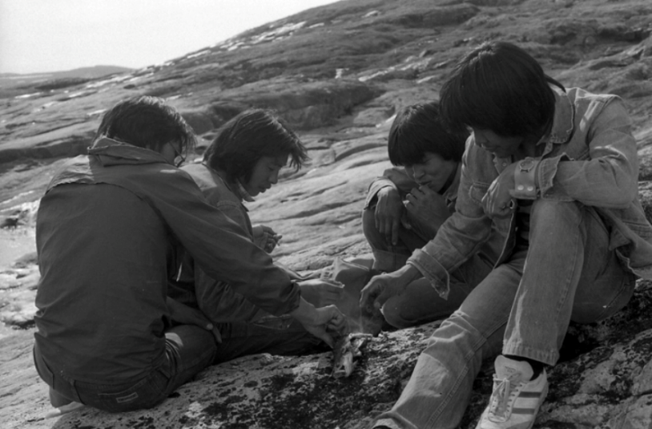
Aspects of society
POLITICAL
SOCIAL
The political aspect is about politics and the way power and authority takes place in a society. The political aspect can be about many things, like political ideas, rules or laws.
The social aspect is about groups and individuals' characteristics in a society and their way of interacting. The social aspect can be about the way of life, the population, work conditions, etc.
13

Slide 15
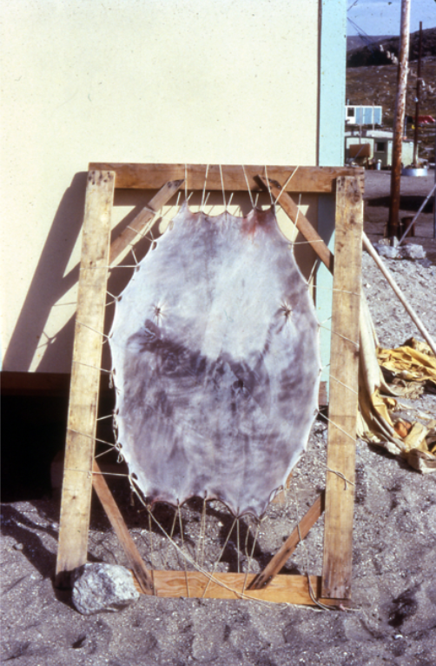
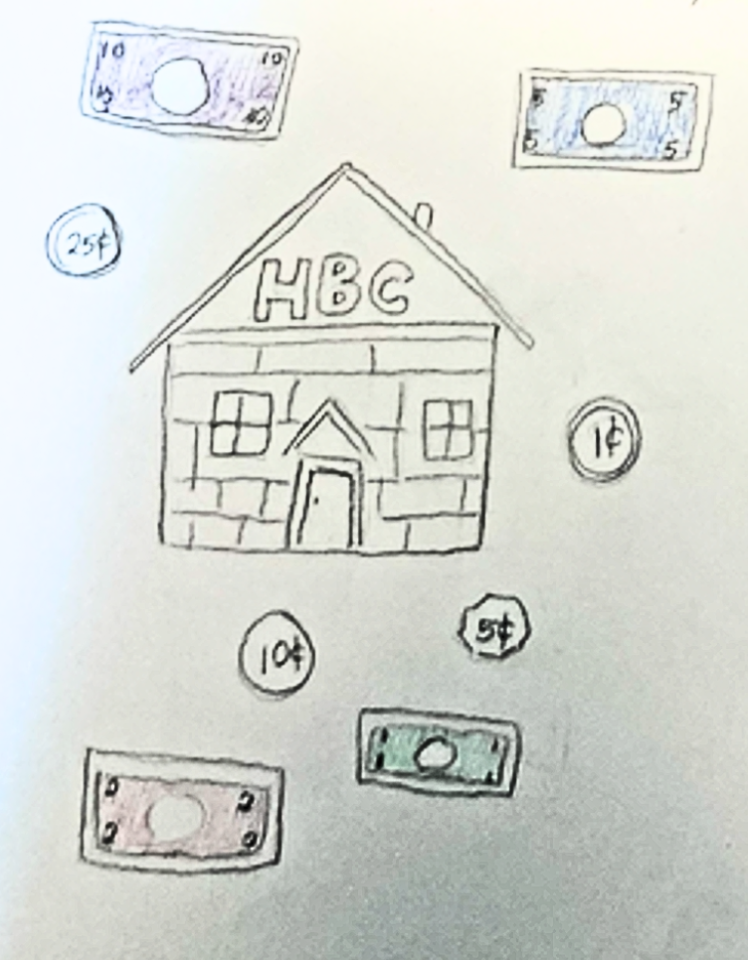
Aspects of society
CULTURAL
ECONOMICAL
The cultural aspect is about the similarities in a group at a certain time. Theses similar characteristics can be expressed through traditions and beliefs. Cultural aspects can be about language, art, religions, way of thinking, etc.
The economical aspect is about natural resources exploitation, production of goods and services as well as trades between people or between groups. Economical aspects can be about commercial trades, raw materials, sources of energy, banks, etc.
14

Slide 16
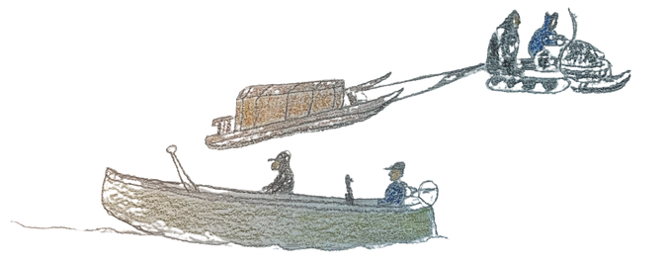
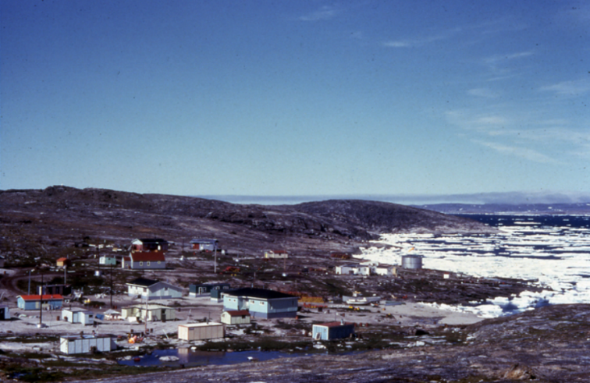
Aspects of society
TECHNICAL
The geographic aspect is about the territory a society occupies to live and its borders. Geographic aspects can be about the natural characteristics of a land, the way of life, the connections to the territory, etc.
The technical aspect is about knowledge and discoveries made by humans that changed a society's way of living. Technical or scientific aspects can be about inventions, philosophers or scientific theories.
GEOGRAPHIC
15

Slide 17
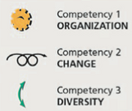
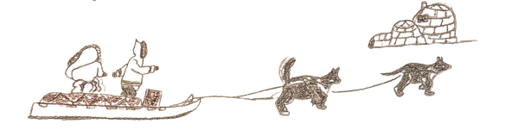
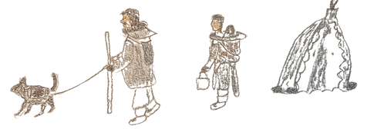
Inuit traditional way of life
Nomads are people who travel as a way of life.
They travel for many reasons : to follow the migration routes of animals, to trade with other groups or for seasonal gatherings
Inuit were nomads for several thousands of years. They moved seasonally, following the migration routes of animals until the 1930’s
After 1930’s, the way of life started to change
16
Notes:
TITLE : INUIT TRADITIONAL WAY OF LIFE AND THE FIRST CONTACTS (TLS #5)
LESSON OBJECTIVES :
Pupils will determine elements of the traditional way of life as well as changes.
TEACHING STRATEGIES
Question plan
Lesson
Exercises in the booklet
INTRODUCTION
Teacher can start with asking pupils what they know about the traditional way of life and what they know has changed
ACTION
Slide 16: Lesson of this slide. Teacher asks pupils to identify if the drawings are from modern life or traditional life. Teacher explains the difference between nomads and sedentary.
To follow-up with the next slide, teacher can ask pupils what they think changed after 1930’s
CONSOLIDATION
Slide 17: Teacher reads the direct quote from slide 17. They invite pupils to answer question #1-2 and to share their answers
Slide 18: Lesson of this slide. Teacher helps pupils answer questions #1-2

Slide 18
Inuit traditional way of life
« Inuit lived in small, family-based groupings that traveled seasonally in pursuit of food. These groups relied upon caribou, fish, sea mammals and occasional treats such as bird eggs or berries to survive. Inuit developed a unique and remarkable skills associated with living off the land. Technologies include the igloo, kayak, ulu, qulliq, fur clothing and toggle-head harpoons. »
The Inuit Way – Pauktuutit, 2006
What are some activities that you still practice today? Personal response
What are some activities that are practiced by some family members today? Personal response
17

Slide 19
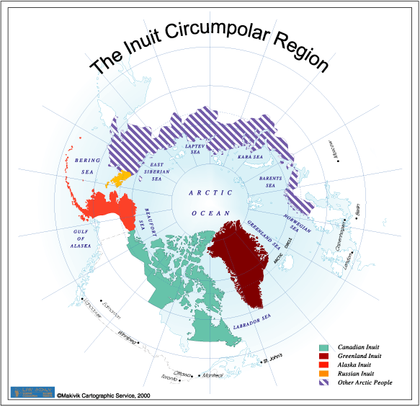
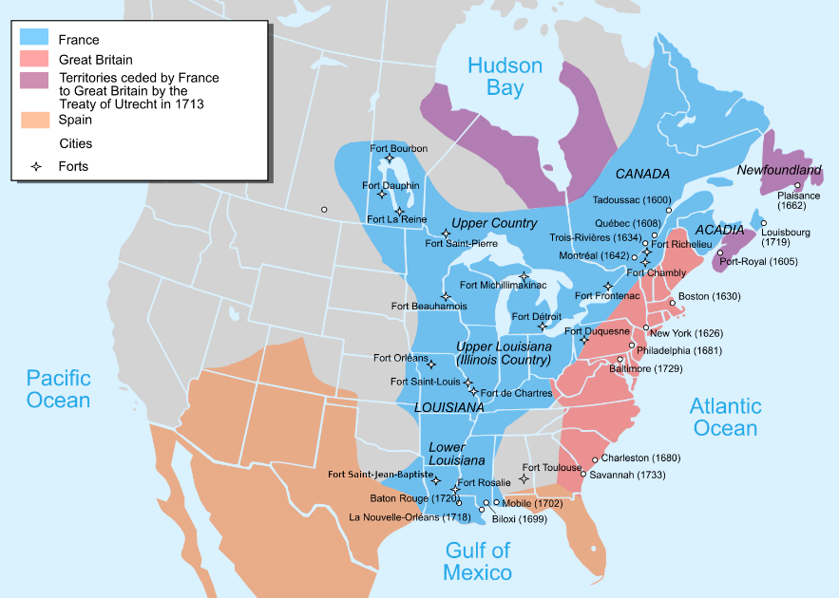
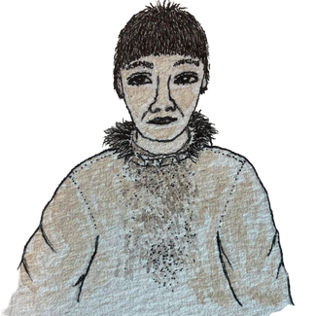
What is the location of the inuit territory?
  North X
  South ____
  East ____
  West ____
Why do you think there were few contacts between Inuit and qallunaat?
Answer example: the qallunaat and Inuit lived far away from each other.
There were few contacts between European settlers and Inuit, as they live mainly in southern Quebec close to the fertile lands of the St Lawrence River.
18

Slide 20

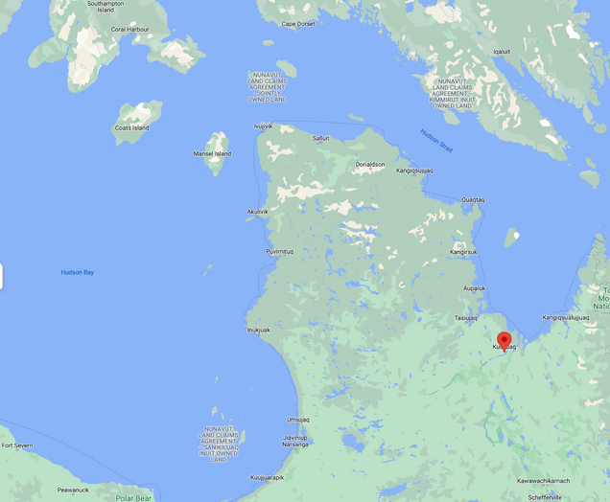
The Hudson's Bay Company trading post
In 1830, Inuit had few contacts with the Europeans, that is until a foreign company settled into our territory : Hudson Bay Company. In 1830, the company settled close to the current town of Kuujjuaq. Their goal was to trade resources with Inuit, so they could sell the resources from the land to Europeans.
Map of Northern Quebec
  Circle your hometown on the map.
2. Kuujjuaq is...
  North-West ____
  South-East ____
  North ____
  West ____
… of your hometown.
19
Notes:
TITLE : THE HUDSON’S BAY TRADING POST (TLS#6)
LESSON OBJECTIVES :
At the end of this lesson, pupils will be able to relate the changes the HBC have brought as well as categorize what was traded in and out.
TEACHING STRATEGIES :
Question plan
Exercices in booklet
Activity
INTRODUCTION
Teacher asks questions about Inuit traditional way of life, what they remembered of lesson #5.
Teacher asks pupils what they know of the Hudson’s Bay Company.
ACTION
Slide 19: lesson on slide 19. Teacher shows Kuujjuaq on the map and helps pupils circle their hometown on the map. Using the compass, the group can discuss what is their position according to Kuujjuaq.
Slide 20: lesson on slide 20. Teacher proceeds to ask pupils what has been added on the map and asks what community is nearby (questions #1-2). Teacher can ask if they think there were advantages for Inuit to participate in trades.
Slide 21: In teams of 2, pupils interprete the document and answer the questions #1-2
CONSOLIDATION
Slide 22-23: Pupils cut the elements traded (slide 22) and glues them on slide 23, placing them according to what Inuit traded and what they got in return.
Teacher corrects the activity with the class

Slide 21
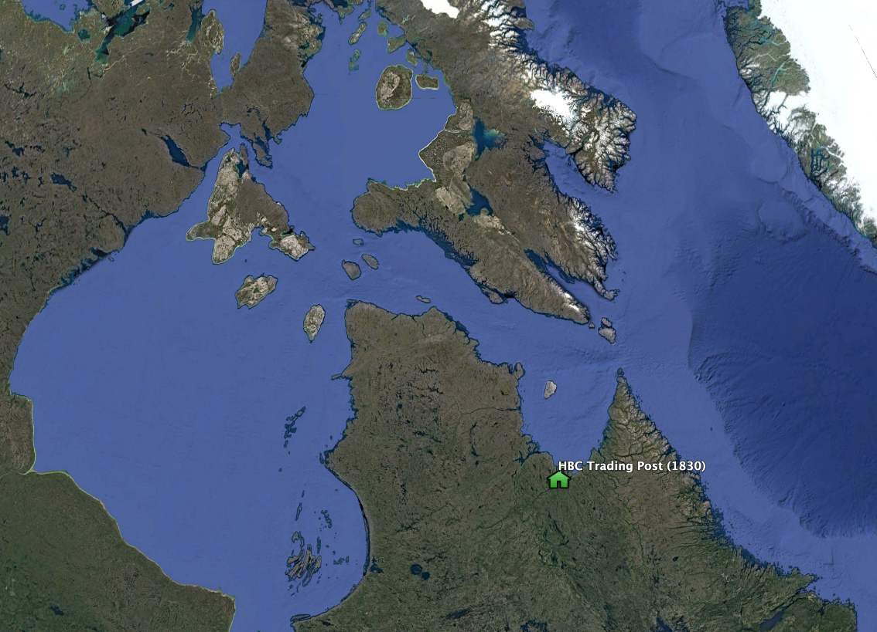
The Hudson's Bay Company trading post
In Nunavik, the Hudson’s Bay Company (HBC) built a first trading post in 1830. What is a trading post? A trading post is a place where Inuit would bring skins, furs, blubber and meat to a foreign company, the HBC. In exchange, the HBC traded ammunitions, firearms, pipes, tobacco, flour and tea.
HBC trading post location (1830)
  What has been added on the map? The location of the first HBC trading post
  Which community is close to this infrastructure? Kuujjuaq
20

Slide 22

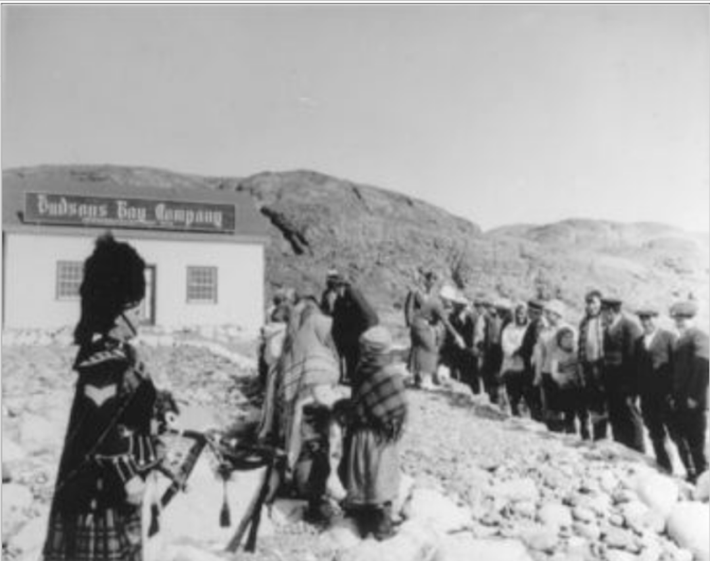
The Hudson's Bay Company trading post
As of 1830, Inuit would stop at the trading posts to trade items, changing their traditional routes
  Look at this picture
  Do you think many Inuit wanted to trade items with the HBC?
  YES NO
  2. What makes you think that? Example of response : There are many Inuit in line or We can see a lot of Inuit waiting outside the post
21

Slide 23






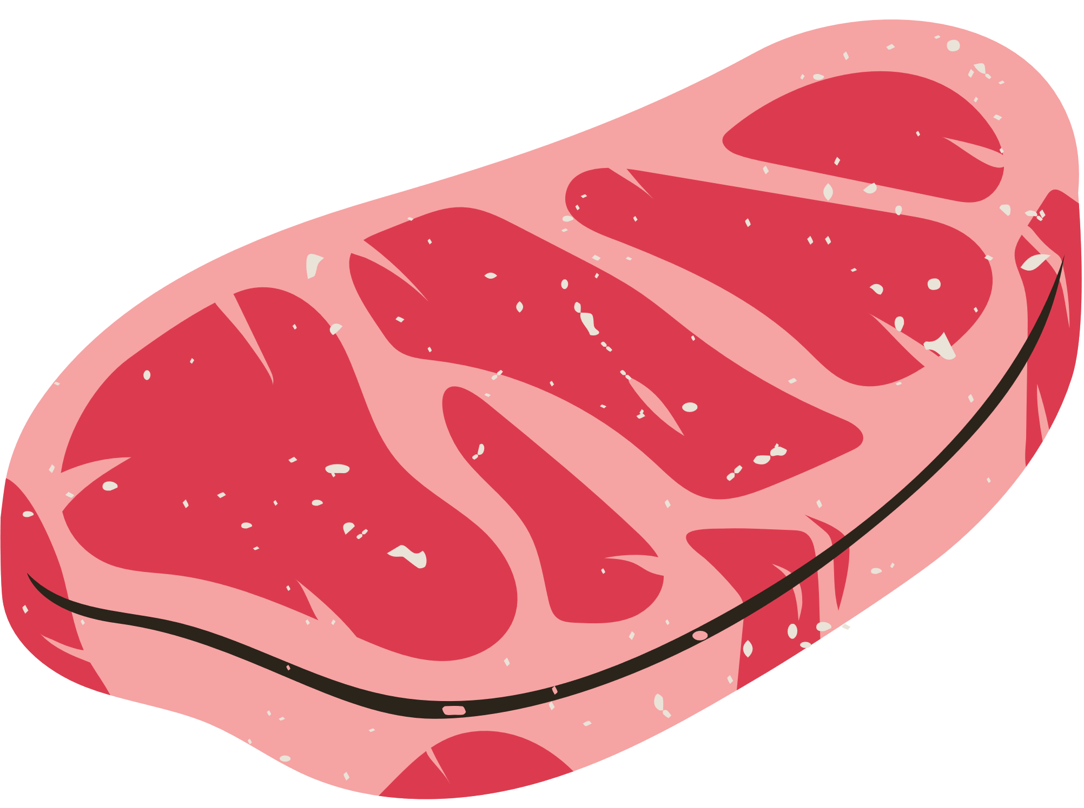



Trading post activity
Cut each trading items
Paste the items on the following page
  On your left : what is traded in by Inuit
  On your right: what Inuit are given in exchange
Tea
Fur
Tobacco
Blubber
Firearm
Meat
Pipe
Ammunition
Flour
22

Slide 24

Fur
Tea
Tobacco
Blubber
HBC
Pipe
Firearm
Meat
Flour
Ammunition
23

Slide 25
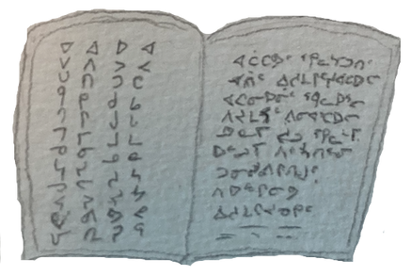
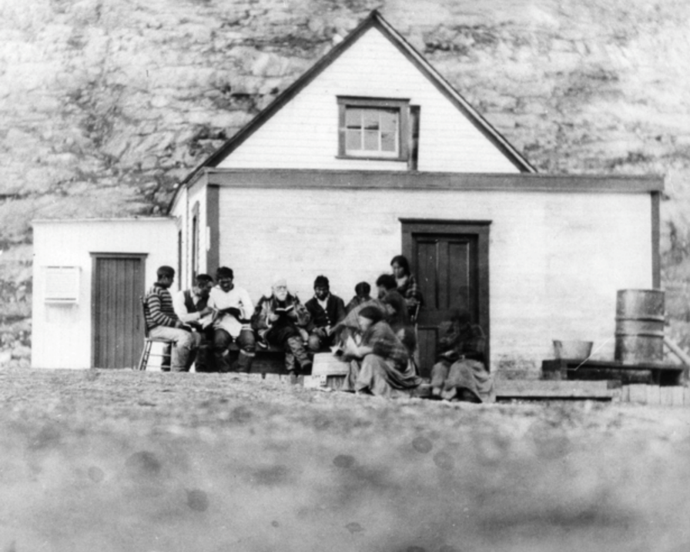
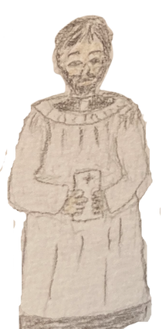
1900's : The missionaries
With the Hudson's Bay company in our territory, contacts between Inuit and Europeans became more frequent, Qallunaat missionnaries came to the North.
I am a missionary. I came to the North to share the Christian religion with the Inuit and teach them.
Did you know…
Inuit had no writing before the 1875's. Syllabics as we know today have been introduced by Anglican missionaries. They did it to translate the Bible.
24
Notes:
TITLE : SYLLABICS (TLS #7)
LESSON OBJECTIVES :
At the end of this short lesson, pupils will identify the moment syllabics were introduced and how the missionaries presence had an influence.
TEACHING STRATEGIES :
Lesson
Video (coming soon)
INTRODUCTION
Teacher can start by asking where they see syllabics around them and what other languages they see often.
ACTION
Slide 24 : Lesson on slide 24. Teacher precises who missionaries are and their goal.
A missionary is a person who has been sent to a place by a religious organization, usually a foreign country, to teach his religion to the people who live there
From the point of view of the organisation, the goal of the missionary is to do God’s will.
CONSOLIDATION
Video (coming soon)

Slide 26


The end of nomadic life
The stockmarket krash of 1929 lead to a lot of instability : people in Europe had less money to buy expensive products such as fur. This meant the HBC couldn’t make as much money as before
The stockmarket krash is an event that leads to economical hardship: businesses had to close, and a lot of people lost their jobs. This lasted for about 10 years, until World War II
The HBC closed many of their trading posts in 1932
What is the cause behind the HBC closing many posts? The HBC closed many posts because of the stockmarket krash or people lost their jobs or Europeans had no more money to buy expensive products
Why do you think Europeans had less money to buy expensive products? The Europeans had less money because they lost their jobs
25
Notes:
TITLE : THE END OF NOMADIC LIFE (PART I) (TLS#8)
LESSON OBJECTIVES :
At the end of this lesson, pupils will determine causes and consequences leading to the end of nomadic life as well as elements of change.
TEACHING STRATEGIES :
Question plan
Lesson
Exercises in the booklet
INTRODUCTION
Teacher asks pupils if they remember what happened when the HBC came to the territory. Answer: way of life started to changes (new tools, new food, new weapons), traditional routes changed, other.
Teacher asks pupils if they know what are causes and consequences in everyday life. Teacher explains a consequence can be positive or negative. Example:
ACTION
Slide 25-26: lesson on slide : cause (stockmarket krash) and consequences (Europeans lost their jobs, hence had no more money to buy fur)
Pupils answer questions #1-2 (slide 25) and question #1 (slide 26) individually and share their answers with the class.
Slide 27: lesson on slide 27. Teacher questions the pupil about the difference they see between both photos. Pupils answer questions #1-2
CONSOLIDATION
Teacher asks students what are the changes that have happened and the consequences on Inuit society.

Slide 27
The end of nomadic life
Without the HBC posts, we have nowhere to sell our
animal, furs, blubber.
Inuit families started to settle. there is less and less animals on the territory and contacts with qallunaat were getting more frequent.
What are the consequences of the HBC closing many posts for Inuit?
The Inuit can no longer sell their furs, their blubber or their animal or Inuit families started to settle or there was less and less animals on the territory or the contacts between Inuit and qallunaat were more frequent.
26

Slide 28
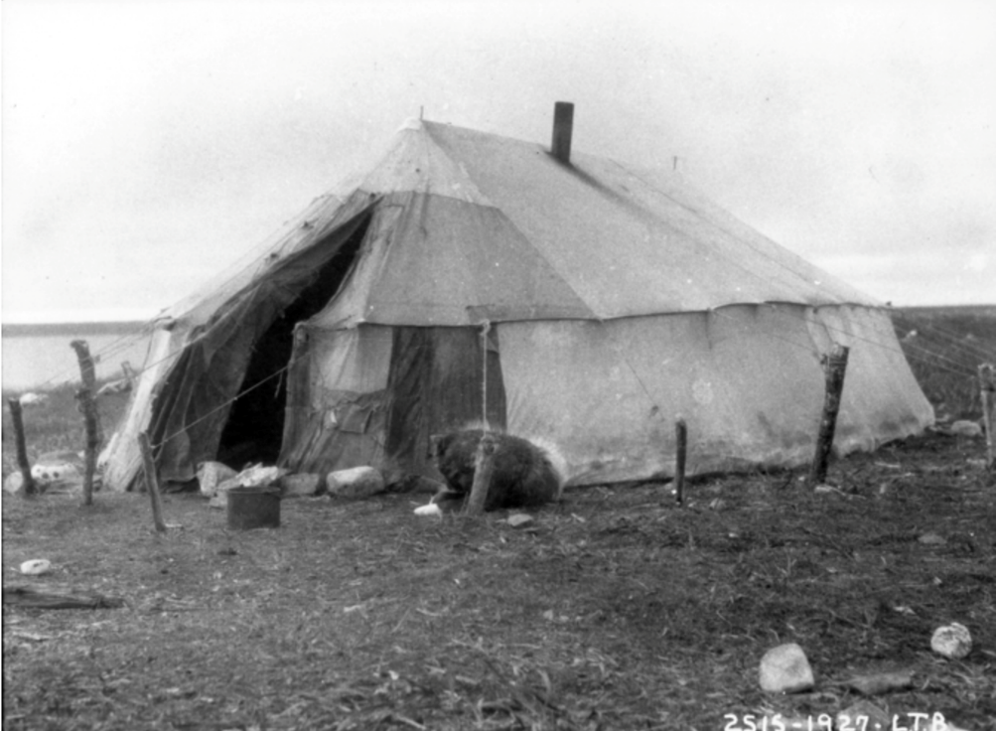
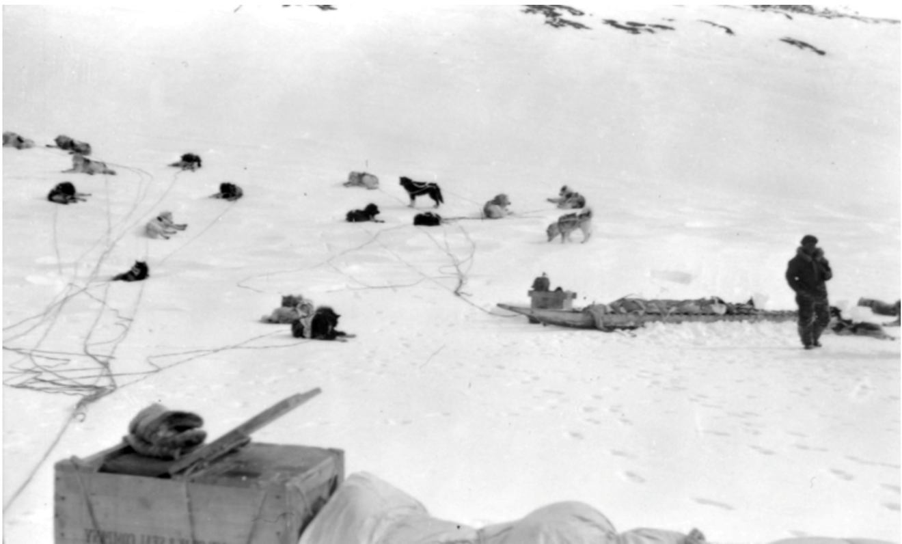
The end of nomadic life
In 1938, a famine struck. That means people did not enough food to survive. Following this event, member of different clans would end up in the same spot and run out of resources in the area.
Each family would stay a distance from each other to take care of their dogs. Life was hard. Inuit started to build homes and camps. They became more and more sedentary. A lot of them stayed around the same area.
Look at the photos. Why are the families staying apart from each other?
The families stay apart from each other because they had dogs to care for
2. Why do you think it was important they did so?
Because their dogs needed space and each family could have many dogs.
27

Slide 29
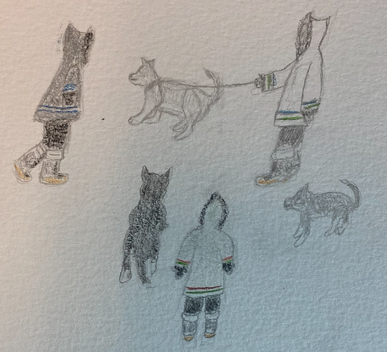
The end of nomadic life
What happened to our dogs?
When the Royal Canadian Mounted Police started to go to the North, they killed dogs.
This caused a lot of suffering : without the dogs, it became impossible to hunt or trap as they used to.
Boys, to become men, they had to have a dog team to be able to hunt and provide food to families.
Dogs teams were really important.
illustration: Passa Mangiuk
From the Inuit point of view, this was meant to force them to start a sedentary way of life.
It was cruel.
From the RCMP official point of view, it was to protect the public from dog attacks and from dogs carrying diseases, such as rabies.
28
Notes:
TITLE : THE END OF NOMADIC LIFE (PART II) (TLS #9)
LESSON OBJECTIVES :
At the end of this lesson, pupils will acquire new knowledge on the consequences of the end of nomadic life and elements of changes in Inuit way of life.
TEACHING STRATEGIES :
Question plan
Lesson
Exercises in the booklet
Video (coming soon)
INTRODUCTION
Teacher asks pupils what they remember of the causes and consequences seen in learning-situation #8. He can proceed to talk about dogs and their importance for Inuit.
ACTION
Slide 29: Teacher talks about infrastructures, what they are and infrastructures in the community. Lesson on slide.
Slide 28: lesson on slide and what happened to the dogs when Inuit sedentarized.
CONSOLIDATION
Video (coming soon)

Slide 30
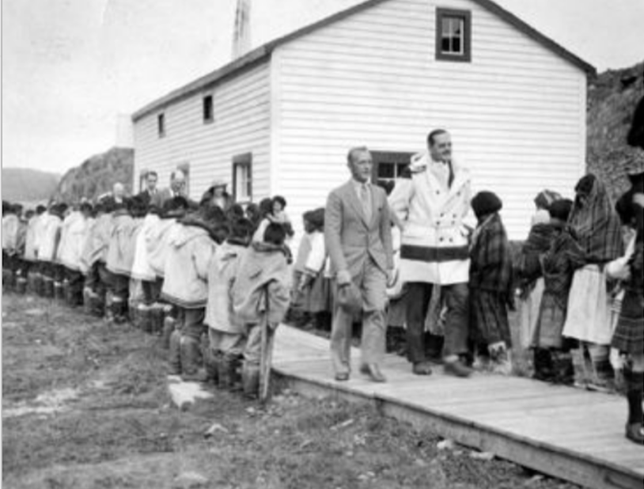
Canada takes over the territory (1939)
I am a government representative. I will settle on the Inuit territory to organize healthcare and education. We will create infrastructures, but I know little about the culture and language of Inuit.
Circle the two things the government representative want to organize:
Can you name a current healthcare building? Response according to the community
Can you name a current education building? Response according to the community
What language does your family speak at home? Either Inuktitut, English or French
What language does the Canadian officials speak? English
A) Do you think Inuit and the government representative understood each other?
YES NO
B) Why?
Inuit and Canadian officials could probably not understand each other because they spoke different languages and their cultures were very different.
Hospitals | Sports teams
Culture | Schools
29

Slide 31
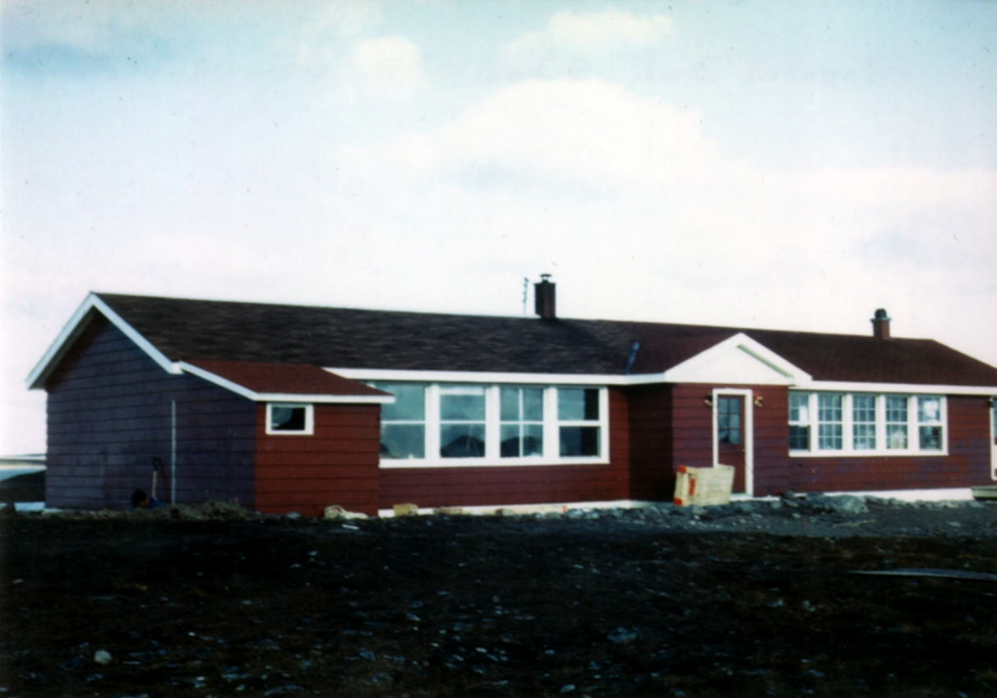
1950's schools
Each community had their own schools managed by Oblates or Catholics missionaries.
Federal school in Puvirnituq in 1960
How many schools are there in your community today? Answers may vary depending on the community
Who is managing your school? Answers may vary depending on the community
Who was teaching in the 1950’s? The Oblate of the Catholic missionaries were teaching
Who is your teacher now? Answers may vary
30
Notes:
TITLE : SCHOOLING IN NUNAVIK (TLS #10)
LESSON OBJECTIVES :
After the lesson, pupils will be able to analyze different struggles experience by Inuit during the schooling process.
TEACHING STRATEGIES :
Question plan
Lesson
Exercises in the booklet
Video (coming soon)
INTRODUCTION
Teacher starts by asking pupils general question about school like who goes to school? Why do you go to school? What a day at school looks like? Who works in the school?
ACTION
Slide 30: lesson on slide. Teacher helps pupils answer questions #1-2-3-4
Slide 31: lesson on slide. Pupils answer questions #1-2 in teams. The whole class can compare their answers.
Slide 32-33: lesson on slides. Teacher shows video Qanuilirpitaa? From 10:45 to 12:45 (testimony of an Inuk who went to Churchill for school: https://curio.ca/en/catalog/c1696599-b997-4b6b-8e42-8ec5a573d706)
CONSOLIDATION
Slide 32: Pupils answer questions #1-5
Slide 33: Pupils answer questions #1-2
Teacher corrects with the whole class

Slide 32


The changes in Inuit communities
After 1960, more Qallunaat arrived in Nunavik since school became mandatory. They would build buildings and few houses.
What difference can you tell regarding seasons in the pictures?
We can see it’s winter in the first picture and summer in the second.
2. What differences can you write between the housing in the pictures?
We can see snow houses (igloo’s) in the first picture and animal skin tent (tupiq) in the other.
31
Notes:
See The Inuit People And Culture Before Their Forced Relocation (allthatsinteresting.com) Utiliser ce photo pour l’été à la place pour que les questions fonctionnent

Slide 33


The school system
As federal schools keep opening in Nunavik, people who would like to pursue in grade 7 needed to go down to Churchill in Manitoba. Students were away for long periods of time.
Map of Puvirnituq and Ivujivik to Churchill, Manitoba
About 970 km
How far do you have to travel from home to school? Answers may vary km
How many hours do you stay away from home in a day? Answers may vary hours
What are the main differences between now and then? The main difference is pupils used to travel a lot more to go to school and they were separated from their families
Do you help your parents with tasks at home? YES NO
A) Do you think the students who went to Churchill could help their parents? YES NO
B) Why? Students who went to Churchill couldn’t help because they were 970 km apart from their parents
32

Slide 34



The school system
As children were away from home to school, their parents no longer had their children around to help them, so the way of life changed more.
Drying fish
Tanning
Making sealskin boots
Do you help your parents with any cultural activity? Answers may vary
Have you seen any cultural activities that you couldn’t help with? Answers may vary
33

Slide 35



The school system
Parents proposed that hunting, fishing and sewing courses will be part of what is taught in school. They suggested people from their community to teach these classes.
Parents were worried that our way of life wasn’t taught to the children.
In 1962, some communities including Puvirnituq introduced
Inuktitut and culture courses.
1970 : The province of Quebec takes
interest in schools
I’m a government representative. I also think that schools should teach Inuktitut from kindergarten to grade 2. Then, French or English can be chosen.
We want to managed the school system.
We want Inuit children to follow our school programs.
34
Notes:
TITLE : TAKING CHARGE OF OUR SCHOOLS (TLS #11)
LESSON OBJECTIVES :
At the end of this lesson, pupils will understand the consequences of Inuit resistance.
TEACHING STRATEGIES :
Lesson
Question plan
Exercises in the booklet
Video (coming soon)
INTRODUCTION
Teacher asks questions about the previous teaching-learning situation #10 : Who were the teachers? Until what grades could pupils stay in their community? How long pupils go to Churchill? How did this change the way of life?
ACTION
Slides 34-35: lesson on both slides
CONSOLIDATION
Video (coming soon)

Slide 36
1979-1980:
The struggle for our schools
At first, schools were managed by the government of Canada.
After, the province of Quebec also opened schools. In the last schools opened, there were parent committees. Parents got involved and we started having a say about what was taught in the schools. Parents wanted our language, our culture and way of life taught to children.
The parent committee
Parents of children would get together to defend an education where we could learn our language, culture and way of life. It made us stronger to get together to demand these changes!
35

Slide 37

1953 : The beginning of the co-ops
People who worked at the co-op in the communities did much more than just business! They would also do tasks similar to one of a city council would do.
Economical aspect
A co-op is a place where people work together towards a goal. The money made from the co-op is shared between everyone who worked towards that goal.
Political aspect
A city council takes decisions on different matters.
For example, they take care of maintaining roads, budgets for the town and make sure their population have access to services.
Do you know someone who works at the co-op? If so, who? Answers may vary
What does your family get from the co-op? Answers may vary
36
Notes:
TITLE : HOW CO-OPS CHANGED OUR LIVES (TLS #12)
LESSON OBJECTIVES :
After this lesson, pupils can identify how Inuit organized with the co-op and the benefits of soapstone carving business.
TEACHING STRATEGIES :
Lesson
Question plan
Exercises in the booklet
Video (coming soon)
INTRODUCTION
Teacher could do a treasure hunt to put pupil’s mind on the subject. Teacher could hide items from the co-op in the classroom and ask pupils where all these items come from and since when Inuit have access to them
ACTION
Slide 36: lesson on this slide, pupils answer questions #1-2 individually
Slide 37: lesson on this slide, pupils answer the questions #1-2 individually
CONSOLIDATION
Slide 38: lesson on this slide, pupils answer questions #1-2 individually
Video (coming soon)
Teacher can ask questions about what pupils learnt about the co-ops

Slide 38


The co-op and the soapstone carving business
In 1953, the co-op starts the business of soapstone carving. It created jobs. Life started to be organized around the co-op. Children would learn to sew traditionally and participate in the business.
Do you know someone who carves soapstone? YES NO
What other uses can soapstone have?
_____________________________________________________________________________________________________________________
Where can you find soapstone? _________________________________________________________________________________
37

Slide 39

The soapstone business
Artists would carve soapstones just as our elders had taught them. They pursued the transmission of traditional art. They are talented, and their work is known everywhere.
Have you ever seen someone carve soapstone?
YES NO
Selling art in the South allowed the members of the co-op to make money, to organize the community and to insure their sedentary survival
38

Slide 40
The steps of the Co-op and the soapstones carving business
Each artist in the business carves soapstone
We get together to share our creations
The co-op buys the sculptures and ships them
The whole community benefits from the business
The co-op makes money with the sculptures
The sculptures are sold in the South
What are the consequences of the soapstone carving business?
The whole community benefits from the business or the soapstone carving business helps the community make money
39
Notes:
TITLE : THE IMPORTANCE OF SOAPSTONE CARVINGS AND CONCLUSION (TLS #13)
LESSON OBJECTIVES :
After this lesson, pupils will define the influence of the co-ops on Inuit’ economy and arts and crafts
TEACHING STRATEGIES :
Lessons
Question plan
Video (coming soon)
Exercices in the booklet
INTRODUCTION
Teacher asks questions about learning-situation #12. (Who benefited from the soapstone carving?; what is a co-op? What other roles did the members of the co-op have?
ACTION
Slide 39: pupils do the activity (#1) and answers questions #2
Slide 40: lesson on this slide, pupils answer question #1
CONSOLIDATION
Slide 41- 42: lesson
Video (coming soon)
Teacher can ask questions about the booklet to get feedback.
What were 3 things that surprised you? What were 3 things that you learnt? What was your favorite fact? What was your favorite activity?

Slide 41




The 1960's:
The soapstone business
In the 1960's, the soapstone business was a great success! The co-ops grew and developed a print workshop, a sewing center and a small store where it sold crafts made by the members of the community.
Connect the dots between the business and the pictures that represents it
Prints
Sewing
Small store
40

Slide 42
The 1960's:
The soapstone business
In 1969, there were 10 co-ops in Nunavik. The co-ops were the main employers and represented over a third of families' annual income
Money made from the co-op (33%)
Other sources of income (66%)
The annual income is the amount of money one family makes in a year.
In the diagram
1 . Color in green, the money made from the coop.
2. Color in orange, the money made from other sources.
41

Slide 43

After 1980's, we no longer lived in tents and igloos, meaning the ties to the territory was different. Our way of living changed, and we joined the market economy. Inuit had to reconstruct their identity since we now lived in communities.
42

Slide 44


Inuit community before 1980's
Inuit community after 1980's
What made Inuit be part of the market economy?
The coops
2. Name some public buildings in your community.
Answers may vary
43

Slide 45
Photo credits
Page # | Description | Location | Avataq reference | Credits
12 | Last matchbox houses in POV, ski-doo | Puvirnituq | IND-MCK G-01421 | Gerald McKenzie
 | Artefact of a cup | Unknown | catalog number HBC : 204 | N/A
 | Artefact of a qulliq | Unknown | catalog number IiDi-4 : 1 | N/A
13 | Delegates hard at work on negotiations between the NQIA and Hydro Quebec (1972) | Kuujjuak | NUN-IWT-36 | Unknown
 | Feasting on a cooked fish (1983) | Kangiqsualujjuaq | NUN-ETO T-0025 | Tommy George Etok
14 | Sealskin drying (1972) | Ivujivik | IND-BMUR-18 | Dr. William Breen Murray
15 | Shore area of the community, showing the oil storage tank, the Coop store, the Anglican chapel and the community center (Quebec House). | Ivujivik | IND-BMUR-04 | Dr. William Breen Murray
21 | HBC governor P. Ashley Cooper and his wife with the people of Cape Smith (Qikiqtarjuaq) assembled in front of the HBC store. The Scottish guard is sergeant Robert Hannah (1934) | Akulivik | A-HBCA-166 | Unknown
24 | Uqammaq reading to a group of Inuit (1919?) | Ivujivik | A-ANG-P 750255I | E.J. Peck
27 | Canvas tent held with wood posts, Summer in Cape Jones Island (1927) | Kuujjuaraapik | A-PA-099626 | L.T. Burwash
 | Kamutik in foreground, a man to the left in the midground. Many huskies resting in a snowy landscape (1953-1954) | Inukjuak | IND-APP-073 | Bill Applewhite

Slide 46
Photo credits
Page # | Description | Location | Avataq reference | Credits
29 | Visit of the Hudson’s Bay Company Governor. Five Qallunaat men, a Qallunaaq woman walking alon a boardwalk surrounded by Inuit (1934) | Killiniq | IND-MCL-130 | Unknown
30 | Puvirnituq Federal Day School (1960) | Puvirnituq | IND-COW M-555 | Mary Cowley
31 | Inuit women standing in an igloo village. (1951) | Ivujivik | A-DES-35 | Frère André Chauvel
 | View of Puvirnituq (1959-62) | Puvirnituq | IND-COW M-561 | Mary Cowley
33 | Two men and a young boy display a large polar bear skin, that is drying on a stretcher (1902-1904) | Kuujjuaraapik | A-QU-L - 22 | A. A. Chesterfield
 | Fish drying rack located near the water (1966) | Salluit | IND-LAU-66 | Pauline Laurin
 | High angle shot of a woman sitting inside a tent, sewing a kamik (1952-1955) | Kangirsuk | IND-LAU-35 | Pauline Laurin
34 | Children inside a classroom, with two writing at the blackboard. All students are back on to the camera, either seated at desks, or standing (1953-1954) | Inukjuak | IND-APP-001 | Bill Applewhite
35 | Wintertime. Long shot of three children standing outside the Co-op store (1966) | Puvirnituq | IND-FUM R-21 | René Fumoleau
37 | Men carving with soapstone (1966) | Ivujivik | IND-BOU-M-5-024 | Pauline Boucher
 | Artist carving soapstone sculpture (1966) | Ivujivik | IND-BOU-M-6-005 | Pauline Boucher
38 | Artist carving soapstone sculpture (1966) | Ivujivik | IND-BOU-M-6-006 | Pauline Boucher
40 | Facade of the POV Co-oprerative store. Taamusi Qumaq in the orange jacket (1978) | Puvirnituq | IND-MCK G-01365 | Gérald McKenzie
 | A display of print on table | Puvirnituq | IND-FUM R-25 | René Fumoleau
 | Nellie Putuguq wearing a caribou skin amautik with coloured beads sewing a caribou skin men’s parka (atigi) (1971) | Puvirnituq | IND-BSA-262 | Bernard Saladin d’Augulure
42 | Tamusi Tulugak in front of the Co-operative (1978) | Puvirnituq | IND-MCK G-03182 | Gérald McKenzie
43 | View of Kuujjuaq village (1949) | Kuujjuaq | ND-MD-52 | Maxwell John Dunbar
 | View of Puvirnituq. Buildings, the school, people walking on the snow (1978) | Puvirnituq | IND-MCK G-01195 | Gérald McKenzie

Slide 47
Reference list
This booklet is based on the knowledge acquired in this thesis: Paul, Véronique (2020). « L'implantation de l'institution scolaire dans les communautés d'Ivujivik et de Puvirnituq au Nunavik : pour une prise en charge locale » Thèse. Montréal (Québec, Canada), Université du Québec à Montréal, Doctorat en histoire. https://archipel.uqam.ca/14430/1/D3905.pdf
Page # | Description | Source
3 | Competencies for 2nd cycle in social studies | Social studies (geography, history and citzenship program) from the Gouvernement du Québec: http://www.education.gouv.qc.ca/fileadmin/site_web/documents/education/jeunes/pfeq/PFEQ_univers-social_EN.pdf
8 | Canada and Inuit Nunangat map | Inuit Tapiriit Kanatami (2019). Map 1 : The Four Regions of Inuit Nuangat. https://www.itk.ca/wp-content/uploads/2019/04/ITK-Map-20190118-digital-rgb.pdf
9 | Province of Quebec map | Google Earth. (2022). Province of Quebec, Canada. www.earth.google.com
10 | Nunavik in Canada | Makivik Corporation (s.d.). Welcome to Nunavik. https://www.makivik.org/wp-content/uploads/2013/02/welcome_to_nunavik.gif
 | Video showing an Inuit map | Canadian Geographie. (2014). Victoria Strait Expedition : Inuit traditional knowledge. Youtube. https://www.youtube.com/watch?v=0YCxBxU6Jmw
11 | Climatic zones in the Province of Quebec | Map : Adam Peterson — Personal work, CC BY-SA 4.0, https://commons.wikimedia.org/w/index.php?curid=50647632
 | Climatic zones photos | Canva Pro
13-14-15 | Aspects of society | RÉCITUS. (s.d.). Guide sur les aspects de société. https://www.recitus.qc.ca/ressources/primaire/publication/aspects-de-societe
17 | Inuit traditional way of life | Pauktuutit. (Inuit Women of Canada). (2006). The Inuit Way : A Guide to Inuit Culture. https://www.relations-inuit.chaire.ulaval.ca/sites/relations-inuit.chaire.ulaval.ca/files/InuitWay_e.pdf
18 | The Inuit Circumpolar Region | Makivik Society. (2000). Nunavik Maps. https://www.makivik.org/nunavik-maps/
 | Qallunaat occupation of the territory in Nouvelle-France | Nouvelle-France:map-en. (s.d.). Dans Wikimedia Commons. https://commons.wikimedia.org/wiki/File:Nouvelle-France_map-en.svg
19 | Map of Northern Quebec | Google Earth. (2022). Northern Quebec, Canada. www.earth.google.com
20 | HBC trading post location | Google Earth. (2022). HBC trading post location. www.earth.google.com
25 | Stockmarket krash definition | Stock exchange. (n.d.). In Britannica. https://kids.britannica.com/kids/article/stock-exchange/353812
28 | What happened to the dogs? | Lévesque, F. (2011). Le contrôle des chiens dans trois communautés du Nunavik au milieu du 20e siècle. Études/Inuit/Studies, 34(2), 149‑166. https://doi.org/10.7202/1004074ar
32 | Map of Puvirnituq and Ivujivik to Churchill, MB | Google Earth. (2022). Northern Canada. www.earth.google.com

